Slide 1


PBTgroup VMobile Project
Initials and Surname: IA Gogela

Slide 2

Outline
1. Introduction
2. Project Objectives
3. Solution Flow Diagram
4. Data Visualization
5. Technology

Slide 3


1. Introduction
The idea of business analytics.
The scope of the project.

Slide 4

2. Project Objectives
What the Project Provides for VMobile:
Data Analysis
Data Preparation
Data Visualisation

Slide 5
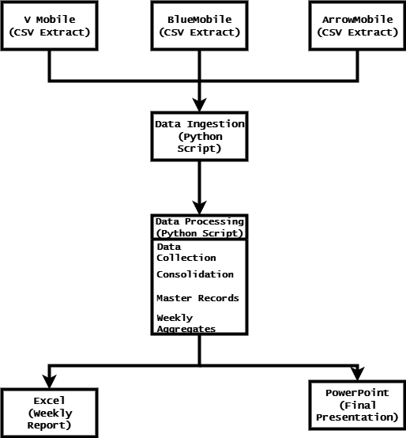
3. Solution
flow
diagram

Slide 6
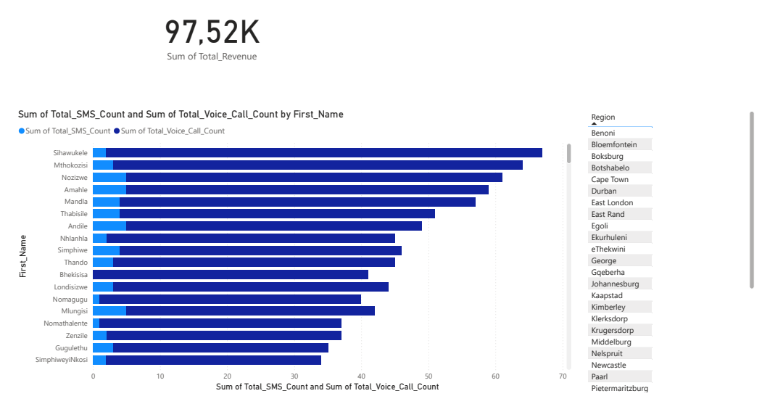
4. Data Visualization

Slide 7
5. Technology
 | Data Analysis | Data Preparation | Data Visualisation | Client Presentation
SQL Server
Python | x | x
PowerBI |  |  | x
PowerQuery
Excel
PowerPoint |  |  |  | x
Canva

Slide 8
Thank you

